Slide 1
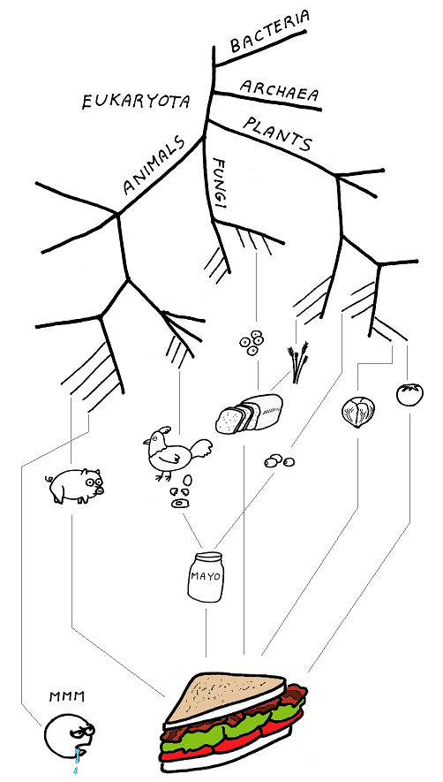
Eco-Evo Lunch
Yoav Ram
Feldman Lab
Stanford University
7 February, 2017
abstrusegoose.com/339

Slide 2

The Evolution of Stress-Induced Mutagenesis

Slide 3
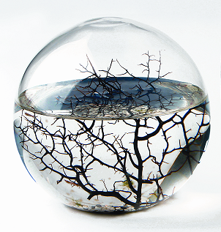

Mutation rate evolution 101
Constant environment
High mutation rates reduce adaptedness of populations
The reduction principle - selection will reduce the mutation rate Liberman & Feldman 1986
Changing environment
Natural selection favors adaptability – ability to adapt
Trade-off
The mutation rate must balance between adaptability and adaptedness Leigh 1973

Slide 4
Variability in mutation rates
Within individuals
DNA polymerase error rate Lynch 2011

Slide 5
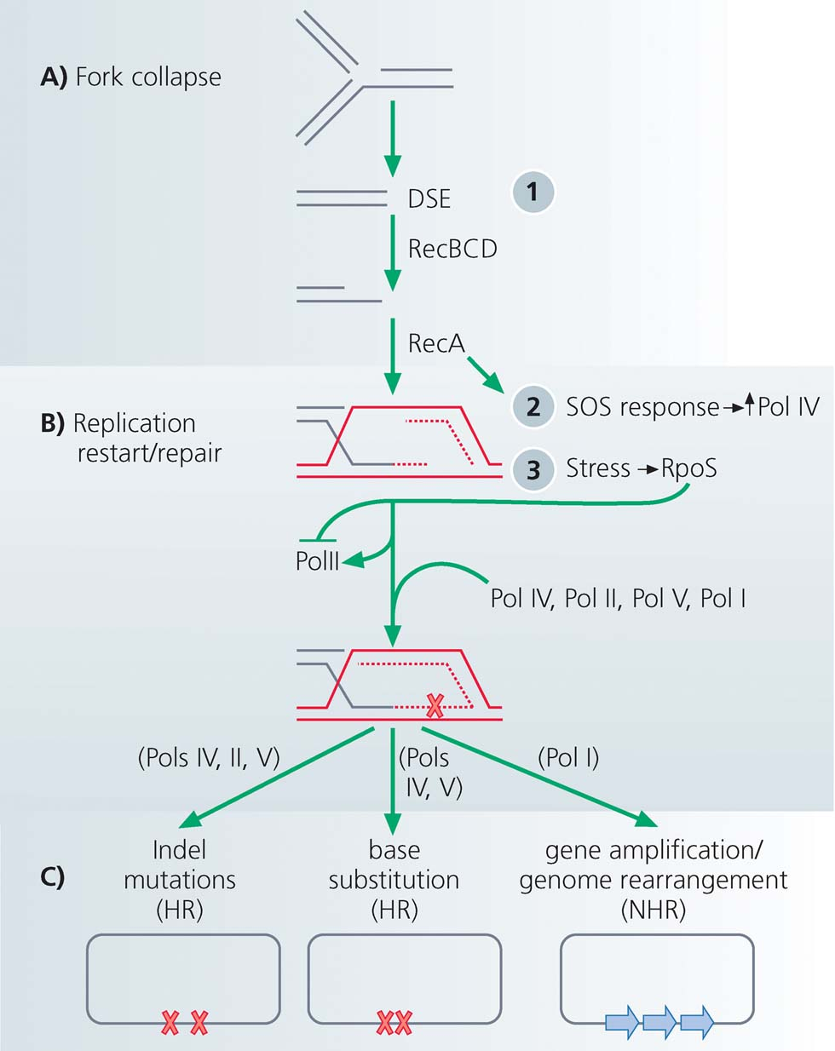
Stress-induced mutagenesis
Rosenberg et al. 2012
In E. coli:
Error prone polymerase induced by stress responses:
SOS response
DNA damage
Starvation
Mismatch repair system
Other mechanisms:
Galhardo et al. 2007
Al Mamun, Science 2012
High-fidelity polymerase
Error-prone polymerases

Slide 6
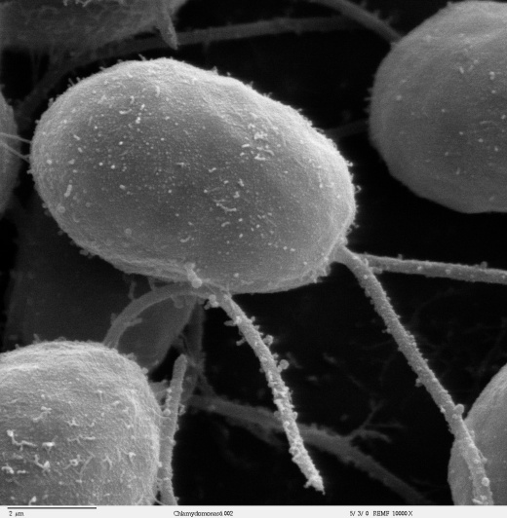
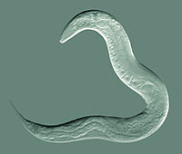
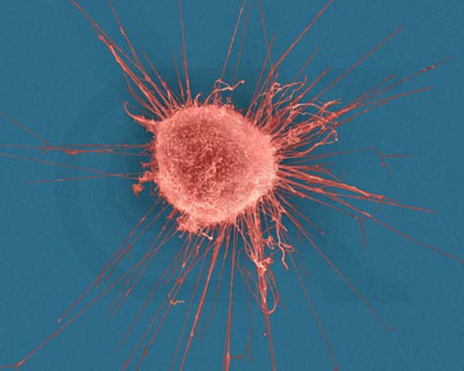
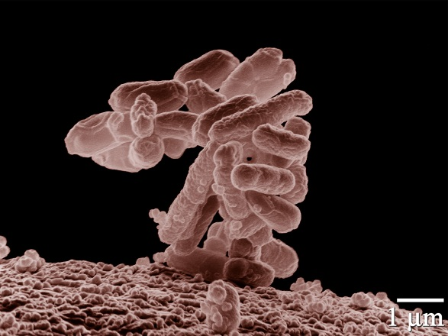
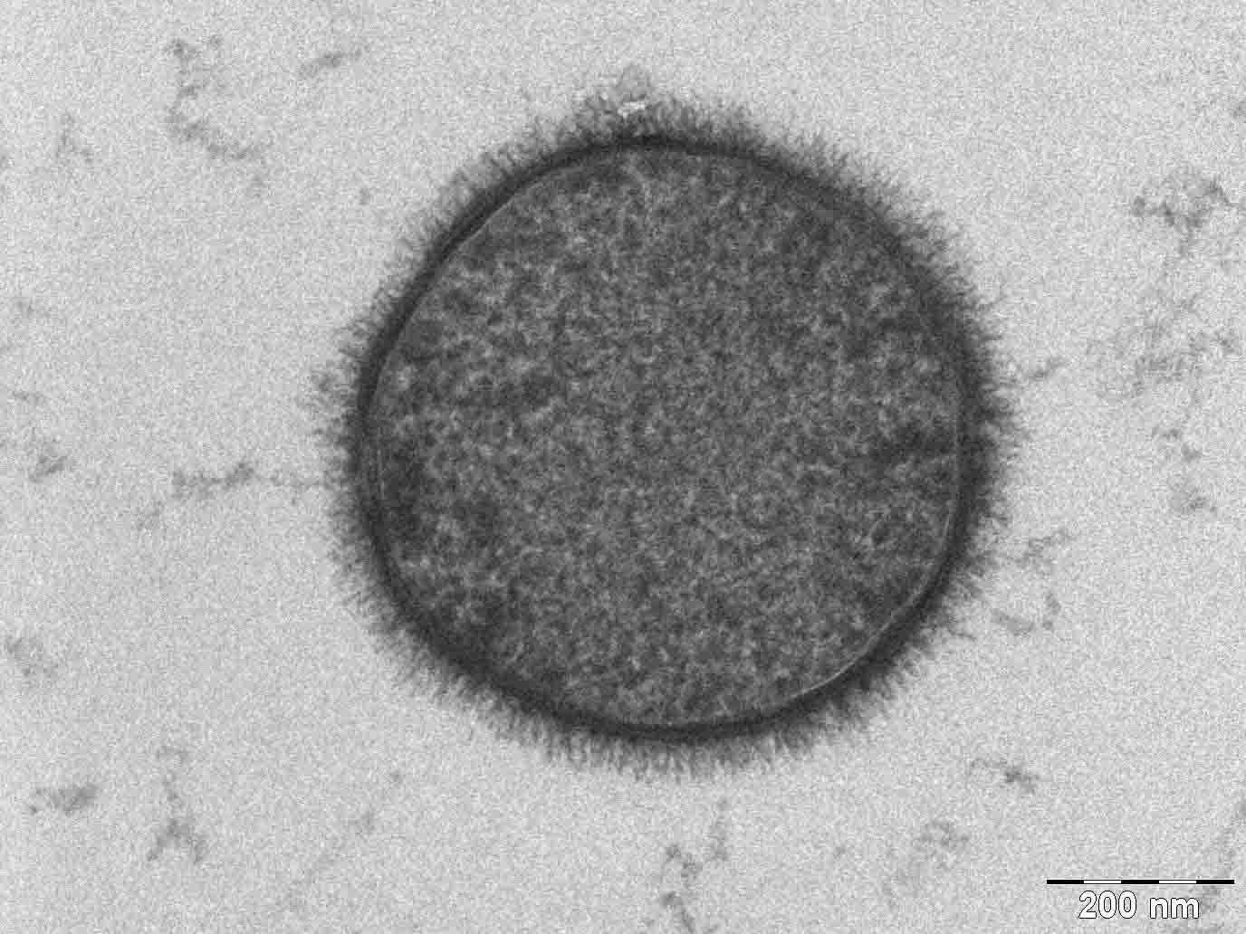
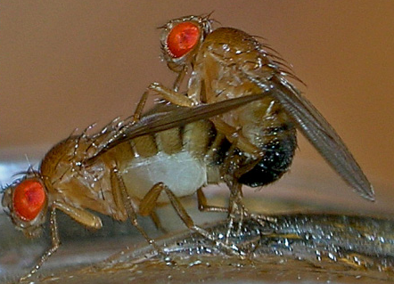
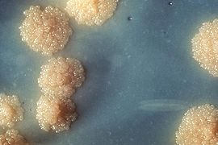
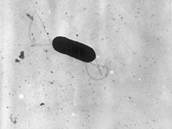
Evidence
Green algea
Nematodes
Bacillus subtilis
Breast cancer cell
M. tuberculosis
L. monocytogenes
D. Melanogaster

Slide 7
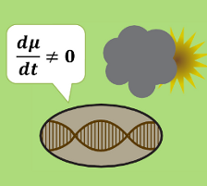
Evolution of stress-induced mutagenesis
Null hypothesis
Mutagenesis is the by-product of stress
Alternative non-adaptive hypotheses
Cost of replication fidelity
Drift barrier hypothesis
Pleiotropy
Adaptive hypothesis
2nd order selection

Slide 8
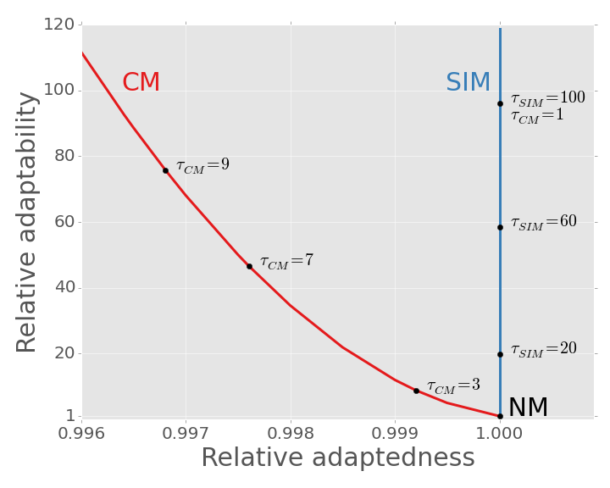
SIM Breaks the adaptability-adaptedness trade-off
Ram & Hadany, PRSB 2014

Slide 9
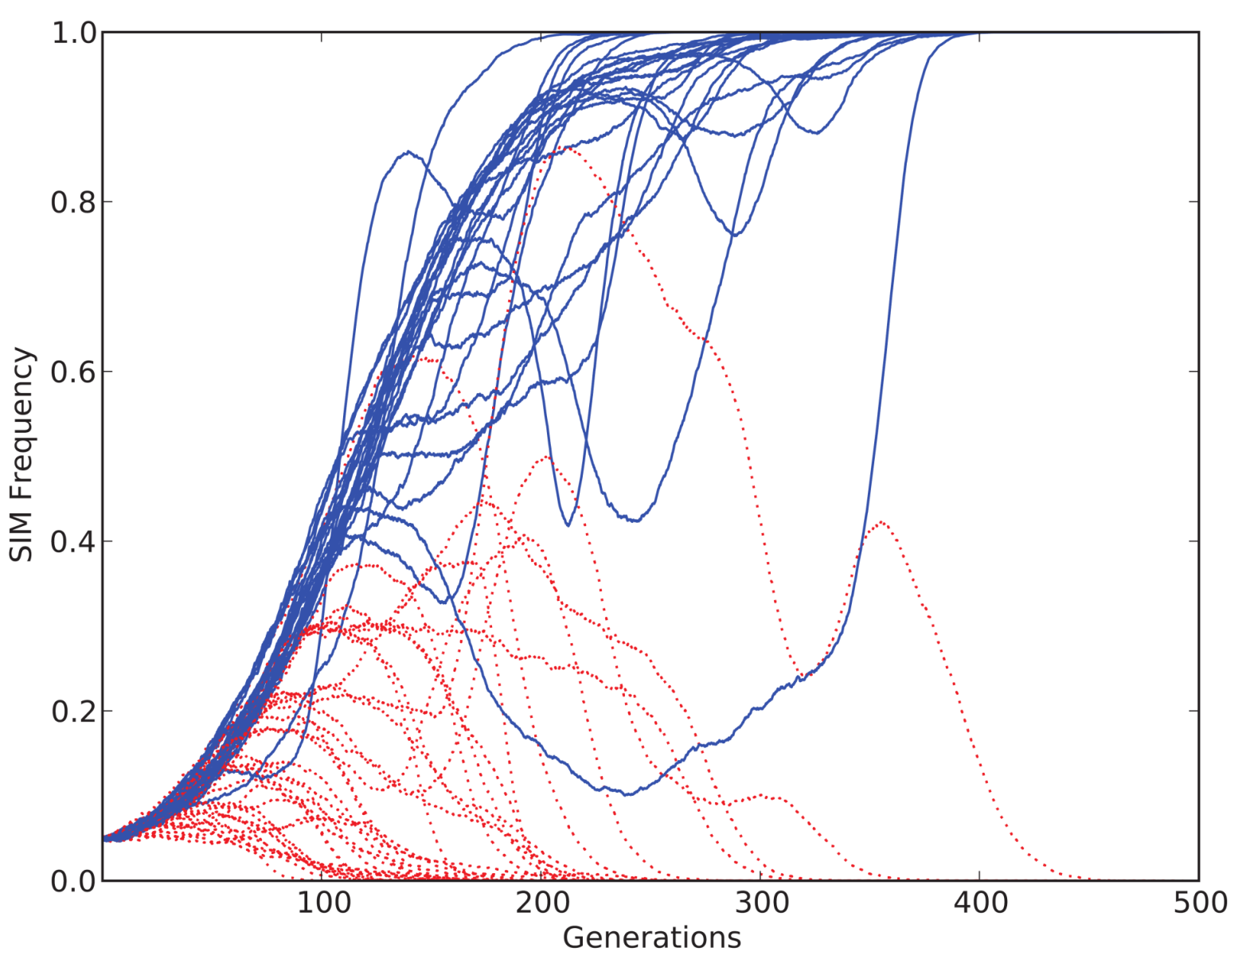
SIM wins competitions
Ram & Hadany, Evolution 2012

Slide 10
Conclusions
Stress-induced mutagenesis evolves:
In constant & changing environments
2nd order selection can lead to the evolution of stress-induced mutagenesis in asexual populations Ram & Hadany, Evolution 2012
More:
SIM & adaptive peak shifts Ram & Hadany, PRSB 2014
SIM in presence of recombination in preparation
SIM with of regulation errors in preparation

Slide 11
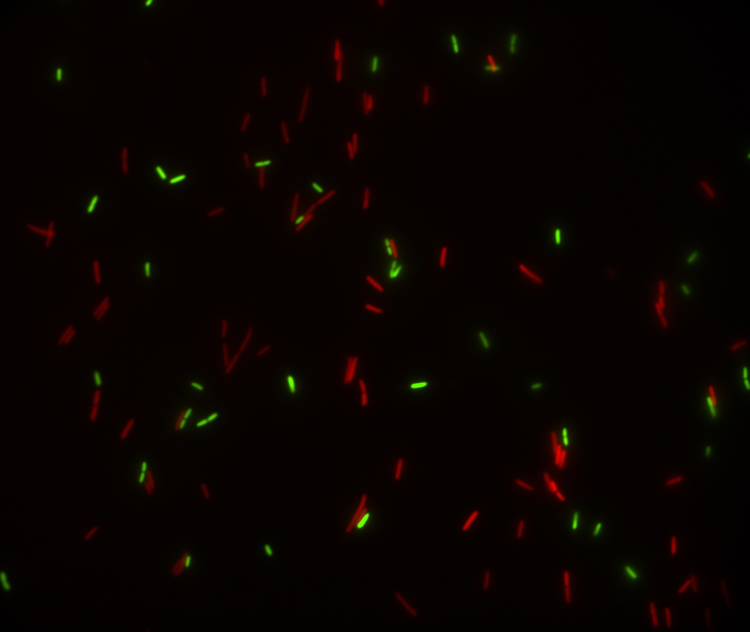
Predicting microbial growth in a mixed culture
Yoav Ram
Feldman Lab @ Stanford
Eco-Evo Lunch, 7 February, 2017

Slide 12
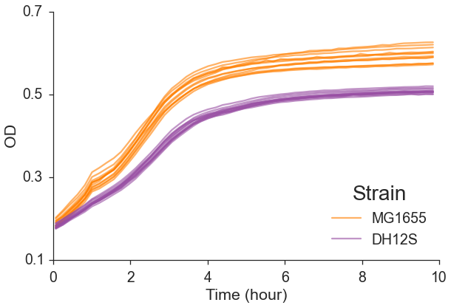
Which is fitter?

Slide 13
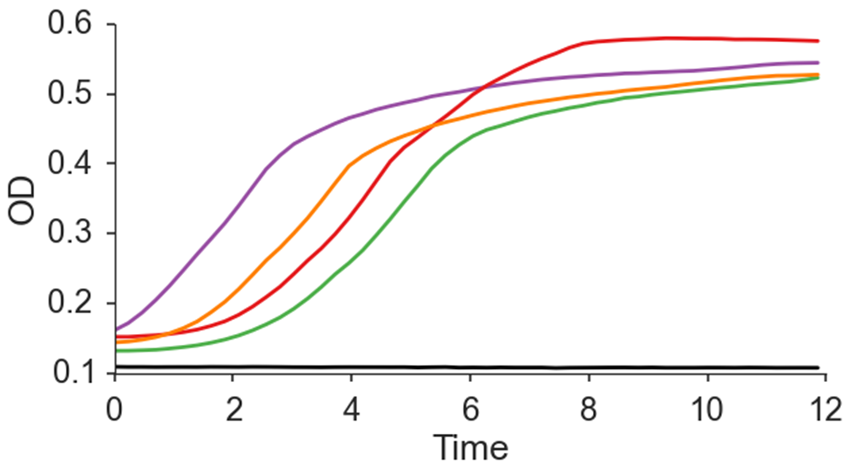
Which is fitter?

Slide 14
How much fitter???

Slide 15
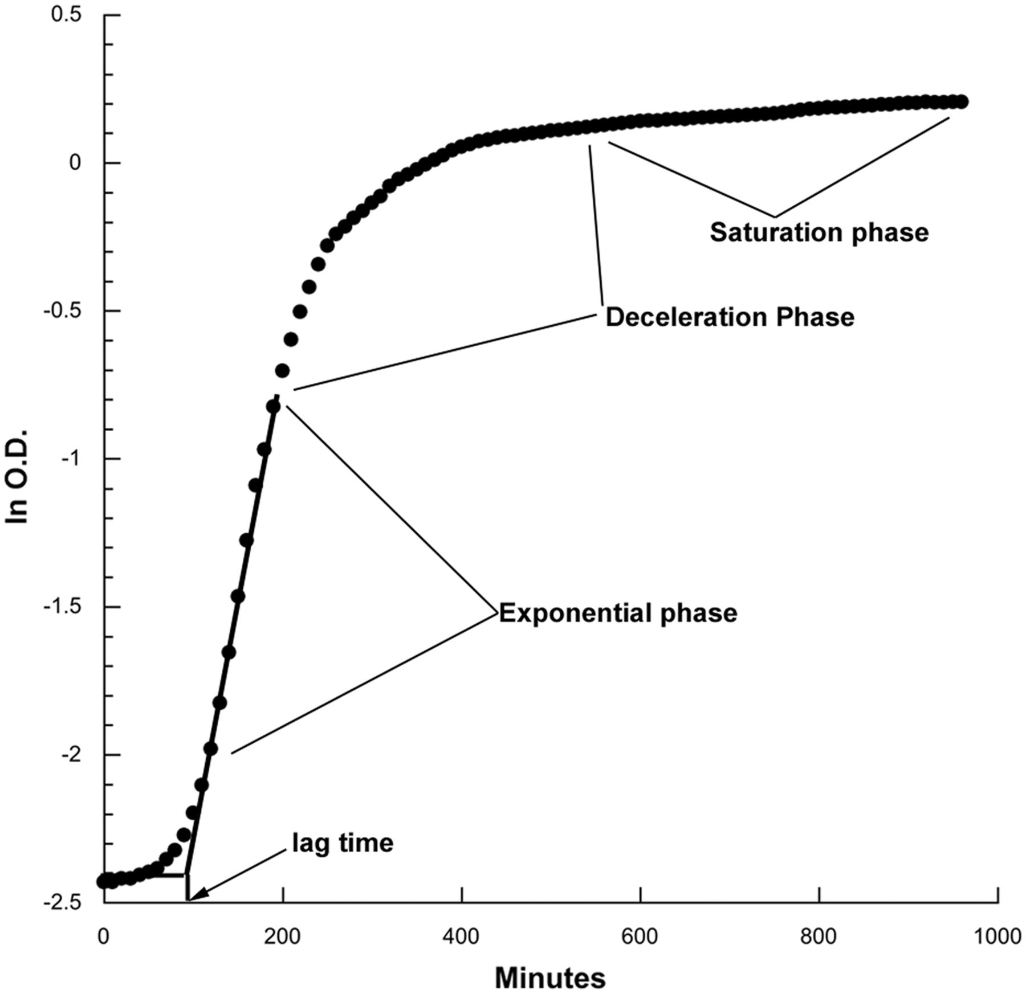
Growth phases
Lag time
Exponential phase
Deceleration phase
Saturation phase
Death phase?
Diauxic shift?
Hall et al., MBE, 2014

Slide 16
Competition experiments
Growth in a mixed culture
Capture all relevant growth phases by direct competition
Also captures direct interactions
CBS Boston

Slide 17
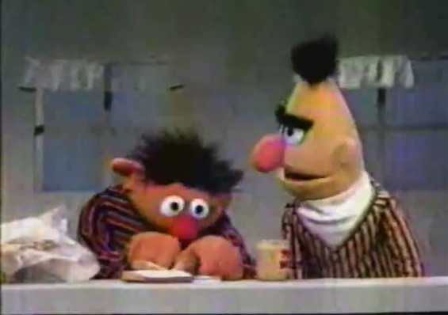
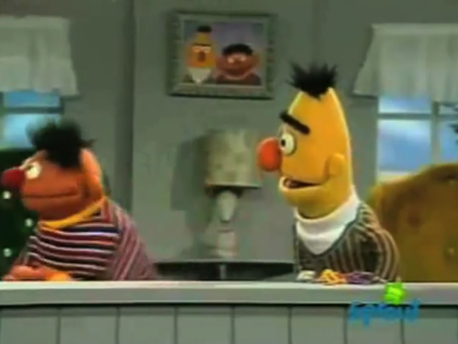

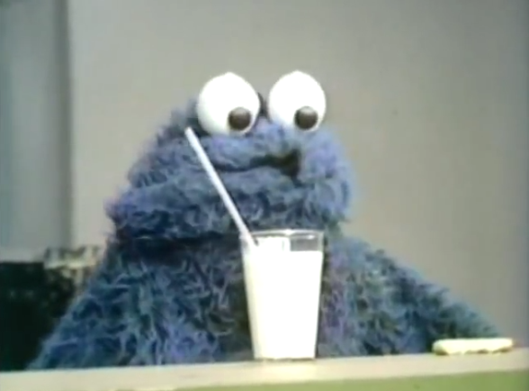
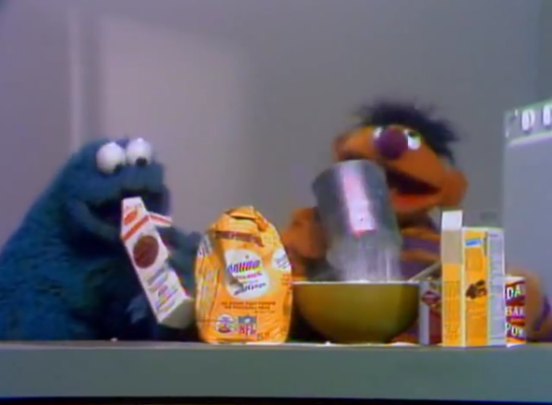
Direct interactions
Cooperation (++)
bread & spread
Interference (--)
The opposite game
Spite (0-)
Quiet please
Parasitism (-+)
Milk & Cookies
Charity (0+)
If I knew you were coming

Slide 18
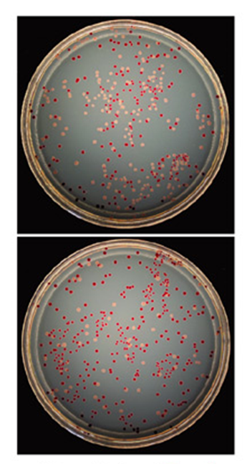
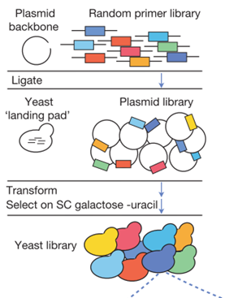
Competition experiments
Strains must have a genotypic or phenotypic marker
Fluorescence and flow cytomery
Gallet et al., Genetics 2012
LTEE: arabinose utilization phenotype
Lenski et al., Am Nat 1991
Lineage tracking with deep sequencing
Bank et al., Evolution 2013; Levy et al., Nature 2015
Ara⁻
Ara⁺

Slide 19
Competition experiments
Strains must have a genotypic or phenotypic marker
Laborious and Costly
More so for non-model organisms
Ara⁻
Ara⁺

Slide 20
Competition experiments
Problem: Laborious and Costly
Our Solution: Computational framework that predicts competition results
Fit growth models to growth curves
Predict competition results
Infer fitness
Ara⁻
Ara⁺

Slide 21
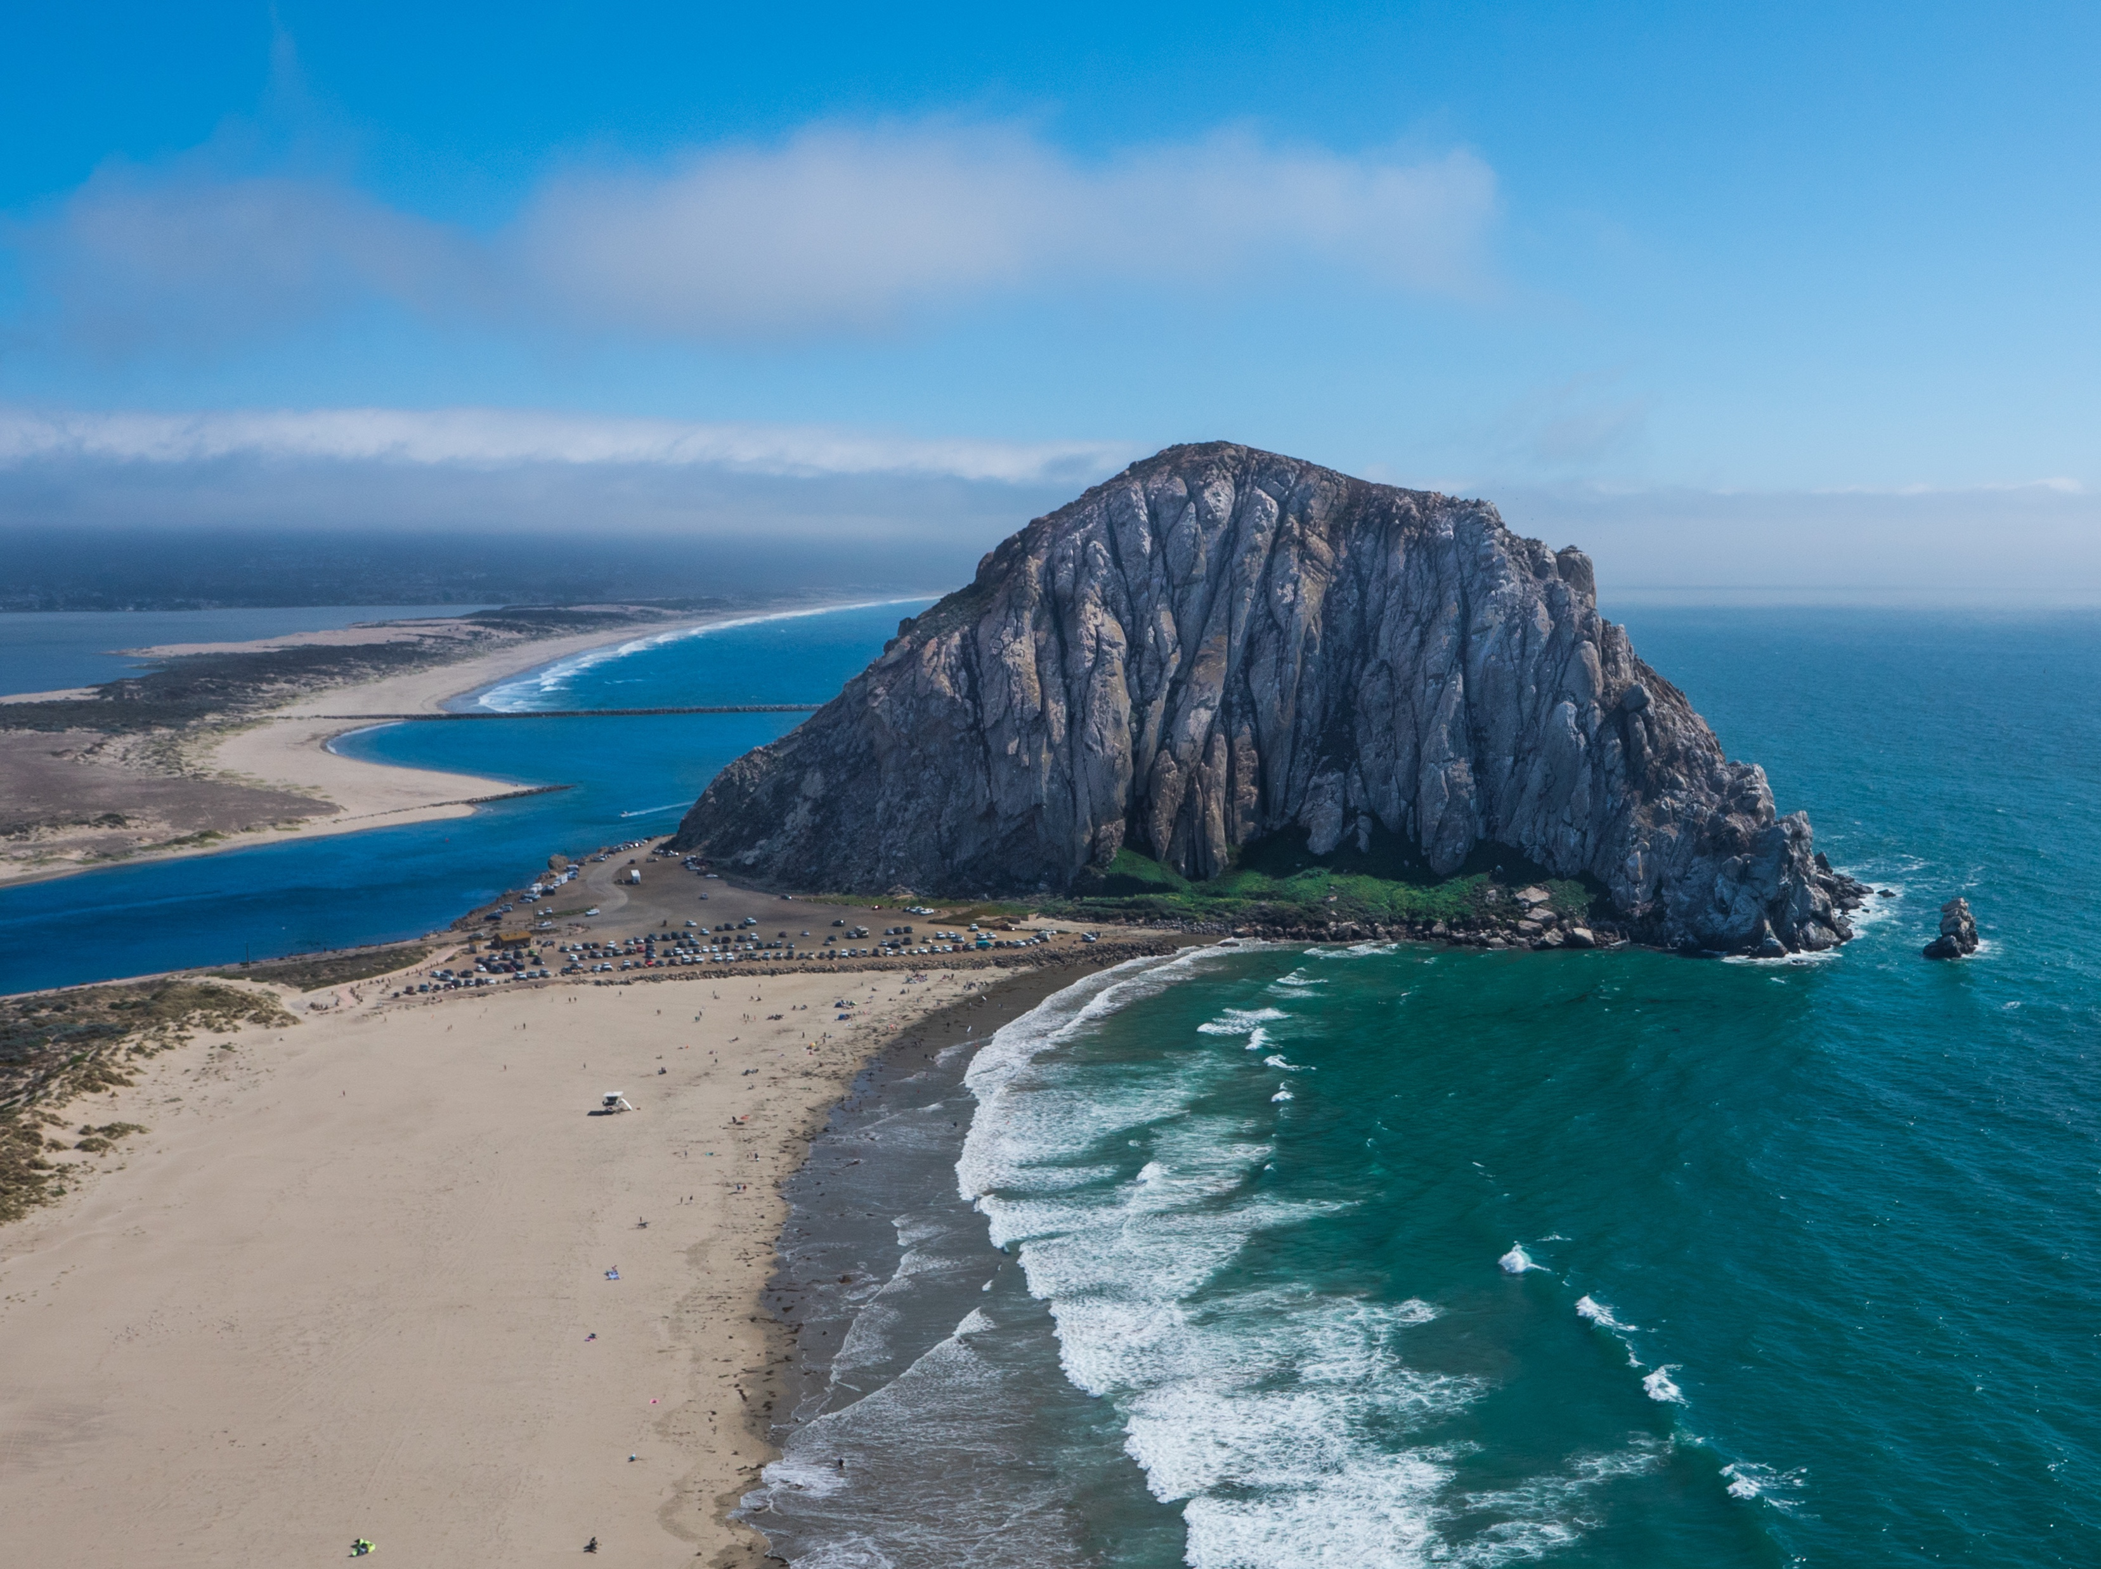
Growth models
Death to the Stock Photo

Slide 22
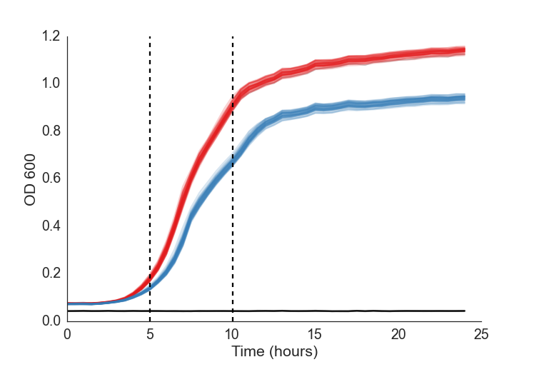

Exponential model
N₀=0.018
r=0.466 hr⁻¹
N₀=0.014
r=0.451 hr⁻¹
$$\frac{dN}{dt}=r⋅N⇒$$
$$N\left(t\right)=N_{0}e^{rt}⇒$$
$$logN\left(t\right)=\log\left(N_{0}\right)+rt$$

Slide 23
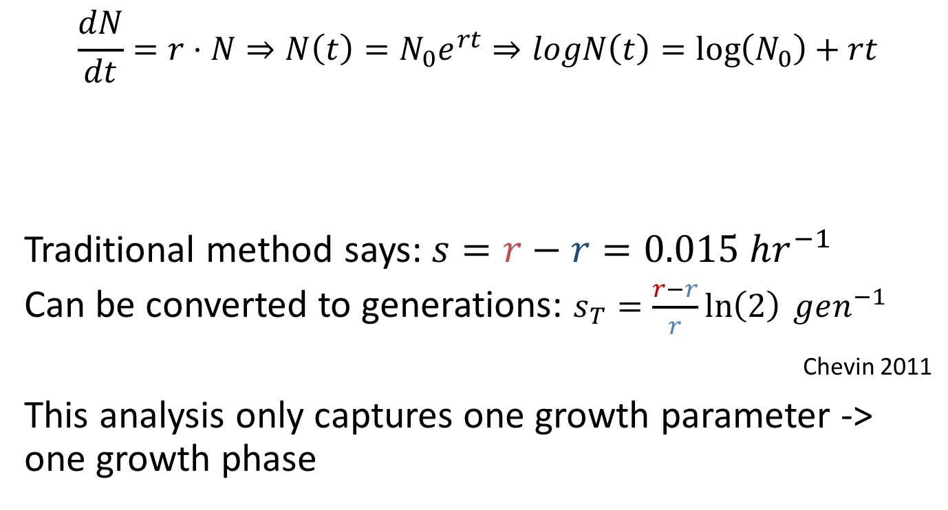
Exponential model
$$\frac{dN}{dt}=r⋅N⇒N\left(t\right)=N_{0}e^{rt}⇒logN\left(t\right)=\log\left(N_{0}\right)+rt$$
Traditional method says: $s=r−r=0.015 hr^{−1}$
Can be converted to generations: $s_{T}=\frac{r−r}{r}\ln\left(2\right) gen^{−1}$
Chevin 2011
This analysis only captures one growth parameter -> one growth phase

Slide 24
Three growth phases?
lag
exponential
stationary
Maybe also
Deceleration phase?
Death phase?
Diauxic shift?

Slide 25
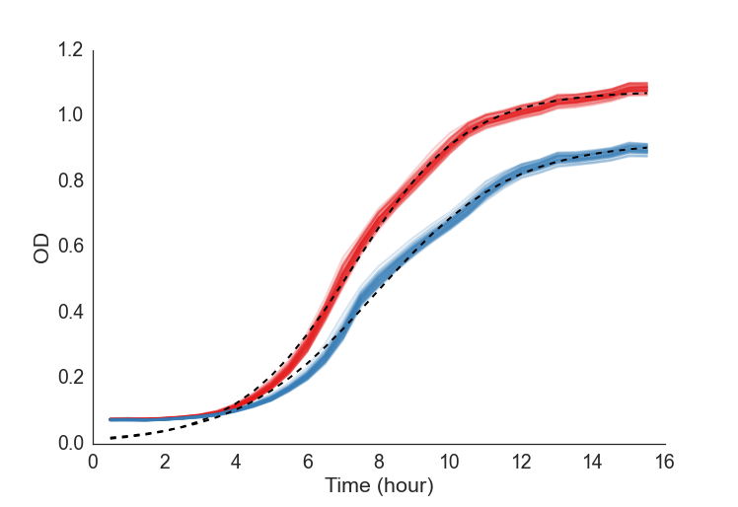

Logistic model
$$\frac{dN}{dt}=rN\left(1−\frac{N}{K}\right)⇒N\left(t\right)=\frac{K}{1+\left(\frac{K}{N_{0}}−1\right)e^{−rt}}$$
r 0.58
K 1.10
N0 0.015
r 0.51
K 0.92
N0 0.015

Slide 26
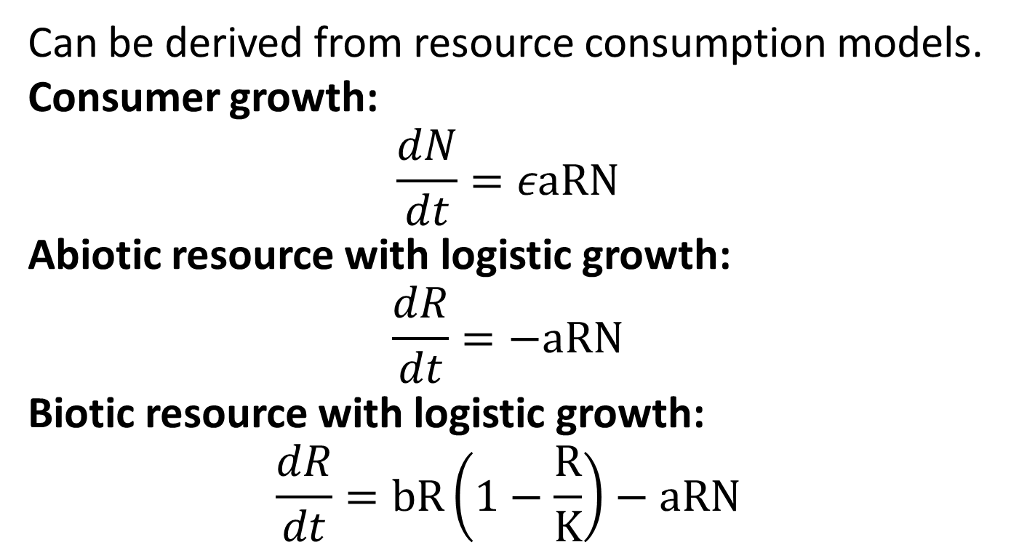
Logistic model: why?
Can be derived from resource consumption models.
Consumer growth:
$$\frac{dN}{dt}=εaRN$$
Abiotic resource with logistic growth:
$$\frac{dR}{dt}=−aRN$$
Biotic resource with logistic growth:
$$\frac{dR}{dt}=bR\left(1−\frac{R}{K}\right)−aRN$$
http://blog.yoavram.com/growth-models/

Slide 27
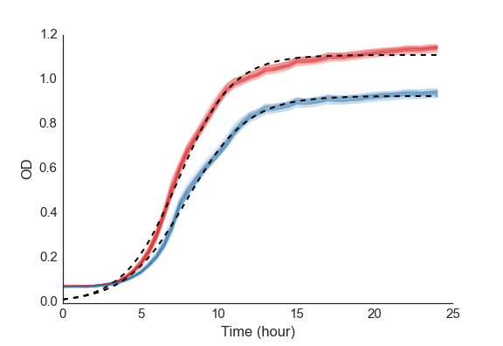

Generalized logistic (Richards) model
$$\frac{dN}{dt}=rN\left(1−{\left(\frac{N}{K}\right)}^{ν}\right)$$

Slide 28

Generalized logistic (Richards) model
$$N\left(t\right)=\frac{K}{{\left(1+\left({\left(\frac{K}{N_{0}}\right)}^{ν}−1\right)e^{−rνt}\right)}^{\frac{1}{ν}}}$$
r 0.62
K 1.11
N₀ 0.012
v 0.898
r 0.434
K 0.92
N₀ 0.02
v 1.32

Slide 29
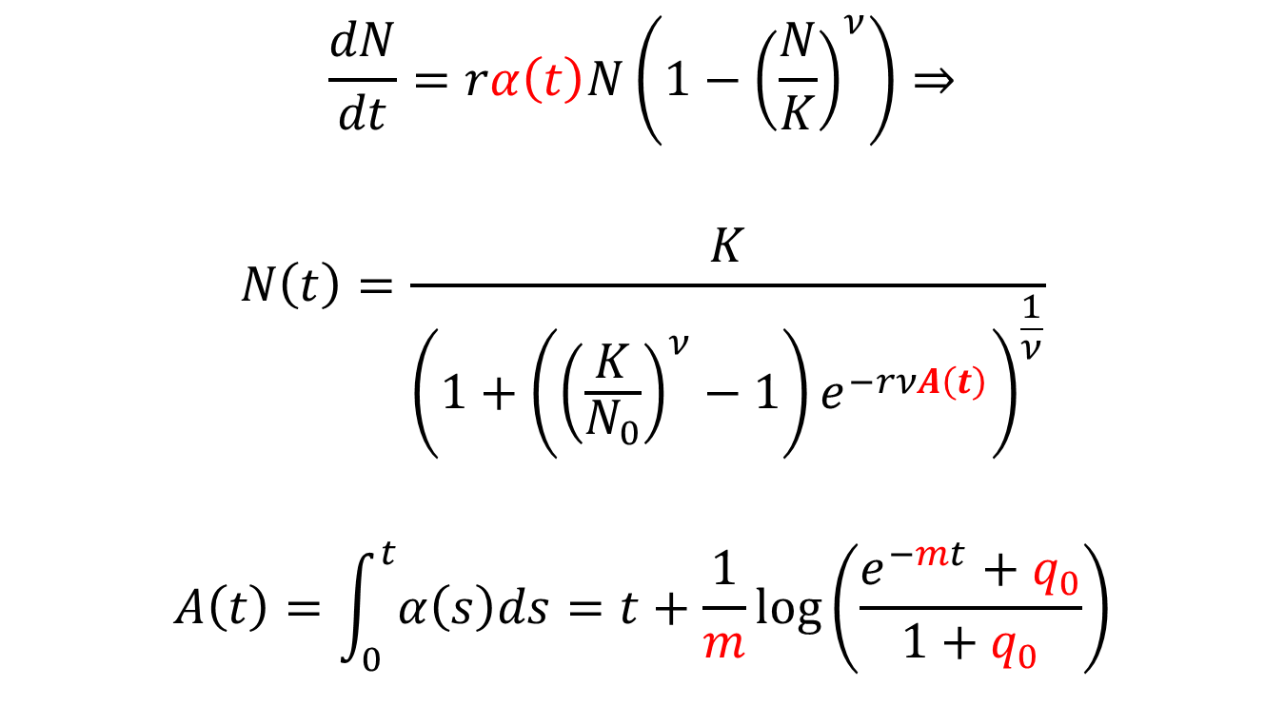
Baranyi-Roberts model
$$\frac{dN}{dt}=rα\left(t\right)N\left(1−{\left(\frac{N}{K}\right)}^{ν}\right)⇒$$
$$N\left(t\right)=\frac{K}{{\left(1+\left({\left(\frac{K}{N_{0}}\right)}^{ν}−1\right)e^{−rνA\left(t\right)}\right)}^{\frac{1}{ν}}}$$
$$A\left(t\right)=\int_{0}^{t}{α\left(s\right)ds}=t+\frac{1}{m}\log\left(\frac{e^{−mt}+q_{0}}{1+q_{0}}\right)$$

Slide 30
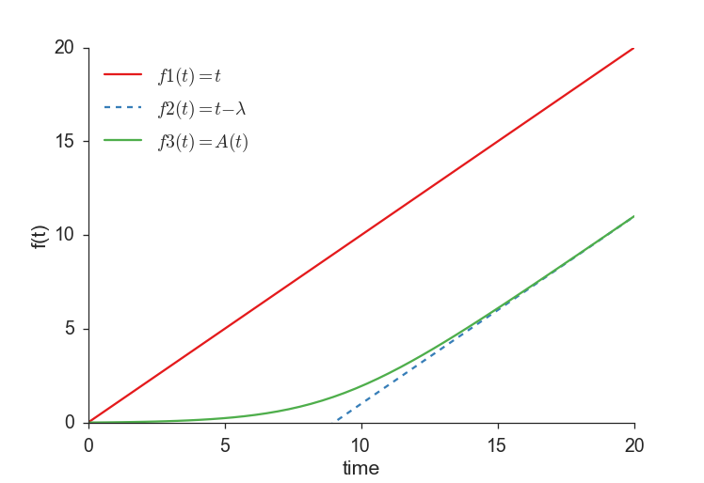
Lag phase

Slide 31
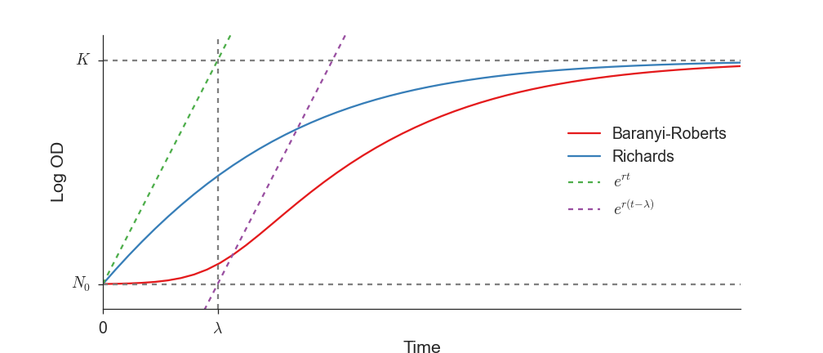

Baranyi-Roberts model
$$N\left(t\right)=\frac{K}{{\left(1+\left({\left(\frac{K}{N_{0}}\right)}^{ν}−1\right)e^{−rνA\left(t\right)}\right)}^{\frac{1}{ν}}}$$

Slide 32
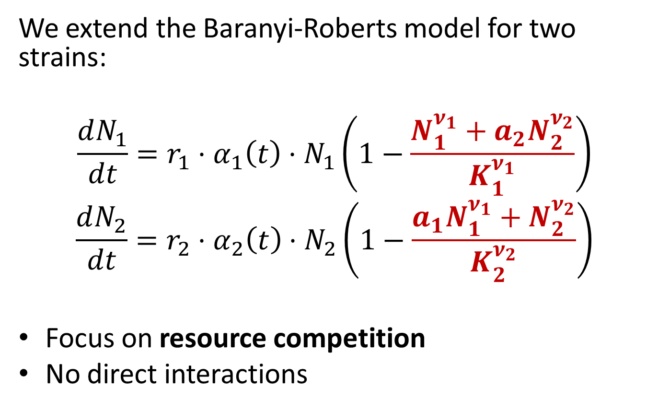
Competition model
We extend the Baranyi-Roberts model for two strains:
$$\frac{dN_{1}}{dt}=r_{1}⋅α_{1}\left(t\right)⋅N_{1}\left(1−\frac{N_{1}^{ν_{1}}+a_{2}N_{2}^{ν_{2}}}{K_{1}^{ν_{1}}}\right)$$
$$\frac{dN_{2}}{dt}=r_{2}⋅α_{2}\left(t\right)⋅N_{2}\left(1−\frac{a_{1}N_{1}^{ν_{1}}+N_{2}^{ν_{2}}}{K_{2}^{ν_{2}}}\right)$$
Focus on resource competition
No direct interactions

Slide 33
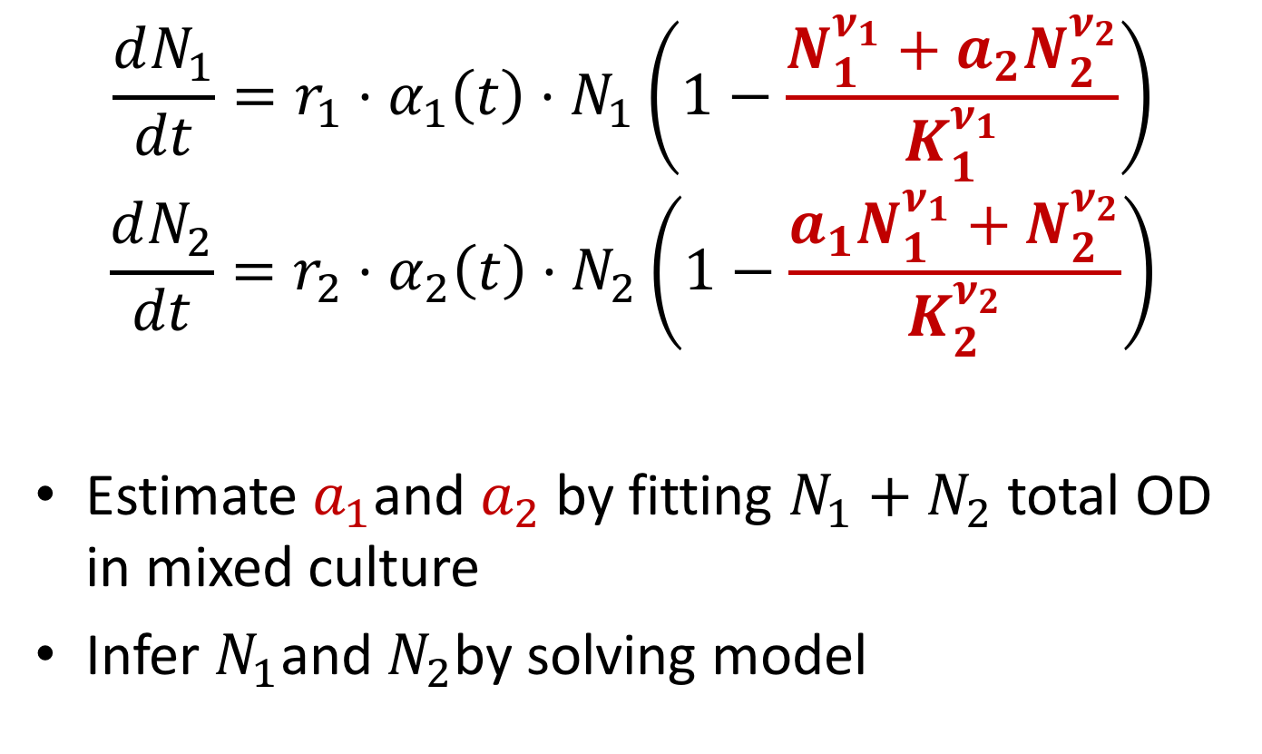
Competitions model
$$\frac{dN_{1}}{dt}=r_{1}⋅α_{1}\left(t\right)⋅N_{1}\left(1−\frac{N_{1}^{ν_{1}}+a_{2}N_{2}^{ν_{2}}}{K_{1}^{ν_{1}}}\right)$$
$$\frac{dN_{2}}{dt}=r_{2}⋅α_{2}\left(t\right)⋅N_{2}\left(1−\frac{a_{1}N_{1}^{ν_{1}}+N_{2}^{ν_{2}}}{K_{2}^{ν_{2}}}\right)$$
Estimate $a_{1}$and $a_{2}$ by fitting $N_{1}+N_{2}$ total OD in mixed culture
Infer $N_{1}$and $N_{2}$by solving model

Slide 34
Testing the predictive framework

Slide 35
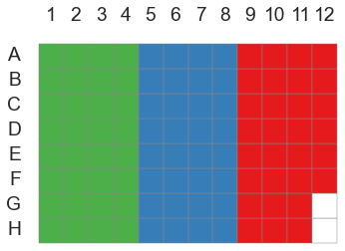
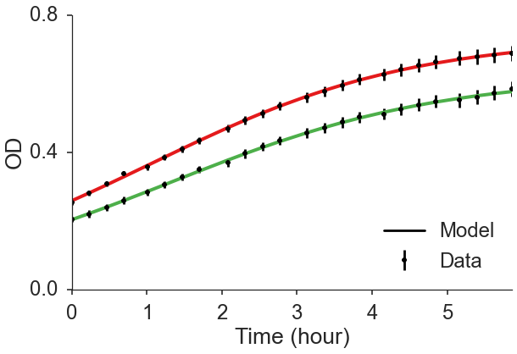
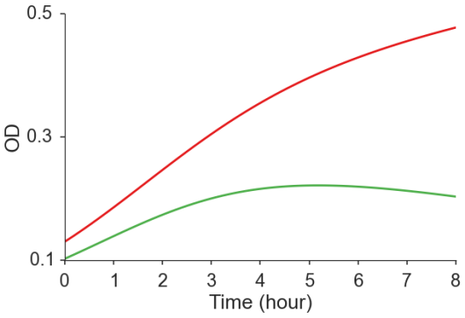
Testing the predictive framework
Two E. coli strains with fluorescent proteins (GFP, RFP)
Growth in mono- and mixed culture
Measure OD over time
Fit growth model
Predict competition results from fitted growth models
Validate predictions using pairwise competition experiments
Use fluorescence to measure frequencies over time

Slide 36
Testing the predictive framework
Two E. coli strains with fluorescent proteins (GFP, RFP)
Growth in mono- and mixed culture
Measure OD over time
Fit growth model
Predict competition results from fitted growth models
Validate predictions using pairwise competition experiments
Use fluorescence to measure frequencies over time

Slide 37
Testing the predictive framework
Two E. coli strains with fluorescent proteins (GFP, RFP)
Growth in mono- and mixed culture
Measure OD over time
Fit growth model
Predict competition results from fitted growth models
Validate predictions using pairwise competition experiments
Use fluorescence to measure frequencies over time

Slide 38
Testing the predictive framework
Two E. coli strains with fluorescent proteins (GFP, RFP)
Growth in mono- and mixed culture
Measure OD over time
Fit growth model
Predict competition results from fitted growth models
Validate predictions using pairwise competition experiments
Use fluorescence to measure frequencies over time

Slide 39
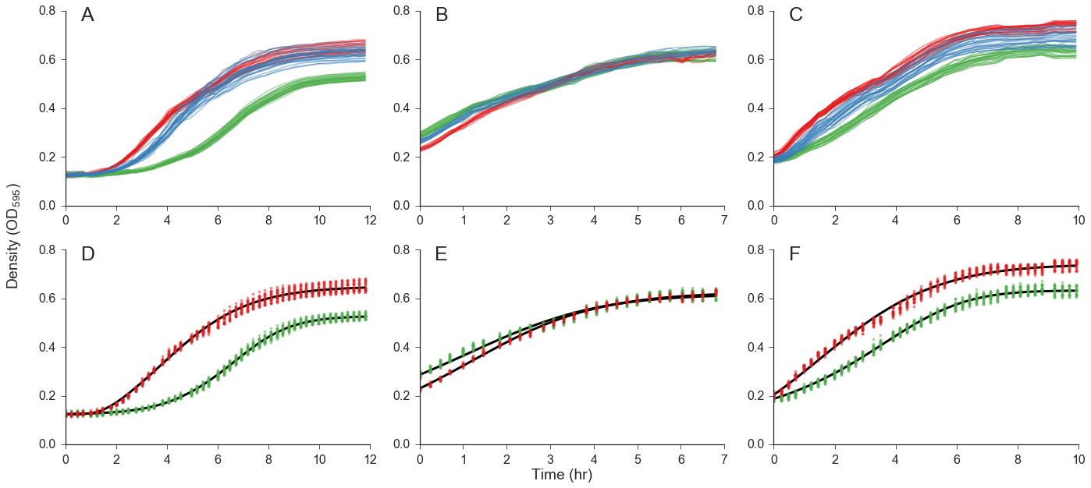
Growth curves data
Top: Data from 3 experiments with E. coli
Bottom: Monoculture data with fitted growth models
DH5α vs. TG1 with lag phase
DH5α vs. TG1 without lag phase
JM109 vs. MG1655Δfnr with lag phase

Slide 40
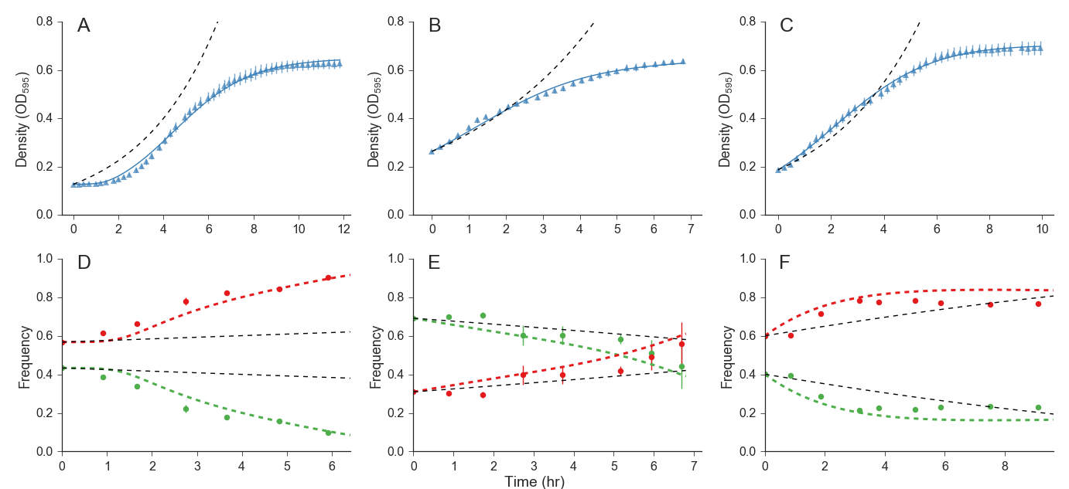
Growth curves data
Mixed culture data with fitted competition models
*Dashed lines are fitted exponential models
DH5α vs. TG1 with lag phase
DH5α vs. TG1 without lag phase
JM109 vs. MG1655Δfnr with lag phase

Slide 41
Competition prediction
Dashed: competition model prediction
Markers: flow cytometry data
*Dashed lines are exponential models prediction
DH5α vs. TG1 with lag phase
DH5α vs. TG1 without lag phase
JM109 vs. MG1655Δfnr with lag phase

Slide 42
Summary
Fit growth models to growth curves
Predict competition results
Infer fitness
Collaborators:
Eynat Dellus-Gur, Maayan Bibi, Uri Obolski, Judith Berman, Lilach Hadany (Tel-Aviv University)
Preprint:
Ram et al. Predicting microbial relative growth in a mixed culture from growth curve data. bioRxiv, doi:10.1101/022640
Software website: curveball.yoavram.com

Slide 43
Test case: Citrate utilization in E. coli
Quandt et al., eLife 2015;10.7554/eLife.09696 (Barrick lab)
mutations in the gltA gene - encodes citrate synthase (CS)
before and after E. coli evolved to grow aerobically on citrate (Cit⁺)
first gltA mutation increases CS activity, beneficial for growth on acetate
contributed to preserving the rudimentary Cit⁺ trait from extinction
Cit⁺ then refined by more mutations
The potentiating gltA mutation became deleterious to fitness
beneficial gltA mutations evolved to reduced CS activity

Slide 44
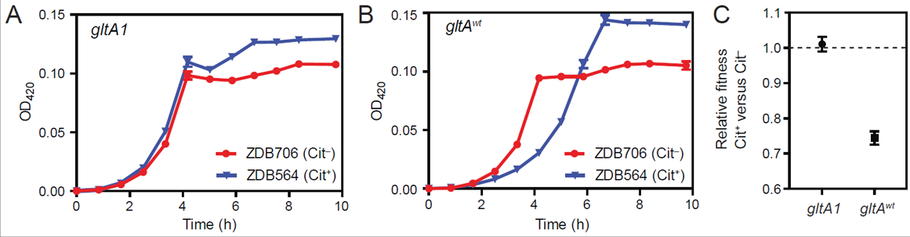
Test case: Citrate utilization in E. coli
Figure 4:
Early Cit+ and Cit- revertant with gltA1 mutation: Cit+ has higher K
Early Cit+ and Cit- revertant with wildtype gltA: Cit- has shorter lag and lower K
Relative fitness Cit+ vs. Cit- from competition assays

Slide 45
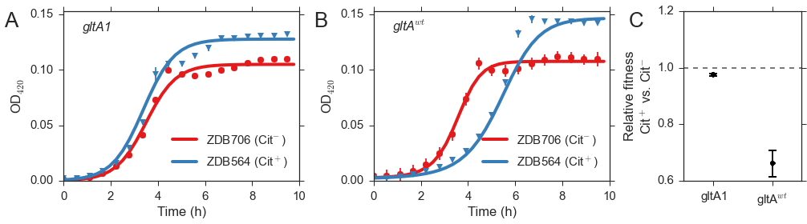
Test case: Citrate utilization in E. coli
Fig. 4 from Quandt et al., 2015
Reproduce Fig. 4 with Curveball using only growth curves data

Slide 46
Test case: Citrate utilization in E. coli
Fig. 4 from Quandt et al., 2015
The discrepancy between panel C In the top and bottom figures can be explained by:
The model fits are not perfect, especially in Cit+ gltA^{wt}: there is a strange “bump” in the curves.
Competition and growth assays were done in different conditions: 100uL x 96 wells vs. 50mL flasks; x10 glucose concentration in growth assays.
Reproduce Fig. 4 with Curveball

Slide 47

Future directions
Complex growth curves:
Bi-phasic growth:
Diauxic shift: glucose-ethanol, glucose-lactose etc.
Changing drug concentrations
Deep stationary phase
Cell death
Null model for detection of direct interactions
Predict adaptive evolution
Interpret fitness differences
Death to the Stock Photo

Slide 48










Acknowledgments
Collaborators on Curveball:
Hadany Lab
Lilach Hadany
Uri Obolski
Eynat Dellus-Gur
Berman Lab
Judith Berman
Maayan Bibi
Israeli Ministry
of Science & Technology
Contact
yoav@yoavram.com
@yoavram
github.com/yoavram
www.yoavram.com

Slide 49

Thank You!
Presentation: github.com/yoavram/EcoEvoLunch2017
Contact
yoav@yoavram.com
@yoavram
github.com/yoavram
www.yoavram.com
Death to the Stock Photo

